Slide 1
Lovinggood Middle School JUNIOR BETA CLUB
Club Sponsors:
Mrs. Jones, Ms. Copening, mRs. D'Emilio
Please scan the qr code for your attendance

Slide 2
GOALS OF THE NATIONAL BETA CLUB
MISSION STATEMENT: To promote the ideals of academic achievement, character, service and leadership among elementary and secondary school students
ACHIEVEMENT - Recognize and honor high academic achievement
CHARACTER - Prepare young people for life and empower them to be successful
LEADERSHIP - Develop the leaders of tomorrow
SERVICE - Demonstrate our motto which is to lead by serving others

Slide 3
LOVINGGOOD MIDDLE SCHOOL JR. BETA CLUB
We are a Division II Chapter of the National Beta Club.
Our branch work to create a positive atmosphere at Lovinggood by serving others and displaying leadership skills.
Members are held at high expectations with exemplary academic progress. You will strive to eventually become mentors for other students.
In past years, Jr. Beta members have participated in community service, Hillgrove Homecoming Parade, Valentine Candy Grams, in the Rising 6th Grade Virtual Tours, clean-up of classrooms and the Lost and Found, programs in neighborhood elementary schools, and in projects that help improve school morale.
We will follow the motto of the National Beta Club which is "Let Us Lead By Serving Others.” This motto is the philosophy upon which the National Beta Club is based on.

Slide 4
Opportunities for being a Member
Make friends and have fun
Make decisions on club activities
Vote on club decisions
Participate in activities at Lovinggood that will improve your leadership skills
Volunteer in community service programs
Mentor future leaders
Celebrate being inducted into the National Beta Club
This Photo by Unknown Author is licensed under CC BY-SA

Slide 5
Membership Requirements
Maintain all A’s and/or B’s in all subjects and all S’s in conduct. Report cards will be checked after each quarter and before the Induction Ceremony.
Attend at least 8 Junior Beta Club meetings one Tuesday per month from 4:30 p.m. to 5:30 p.m. Email Mrs. Jones or Ms. Copening if you know you will be absent from a meeting at marthe.jones@cobbk12.org or nina.copening@cobbk12.org.
Complete 10 hours of school/community service and at least 5 of these hours must be completed with the club. Service hours must be completed, recorded on form, and signed by Ms. Copening by Tuesday, May 2, 2023.
Complete and submit this application and club dues by Tuesday, November 1st, 2022.
Deadlines for due dates must be met.
Membership is a privilege and may be revoked at any time if you fail to meet academic or conduct requirements without refund of dues.
This Photo by Unknown Author is licensed under CC BY-NC-ND

Slide 6
Membership dues
The club membership dues are $30.00 for new members and includes registration fee, membership card, membership certificate, membership pin, and a club t-shirt.
Returning members dues are $15.00 and includes club activities and upholds membership.
Dues must be paid by Tuesday, November 1, 2022. Make checks payable to Lovinggood Middle School.
Mark JR. BETA CLUB on the front of the white envelope and put in the black drop box.
Please make sure to write student’s name on all correspondence.
This Photo by Unknown Author is licensed under CC BY-SA

Slide 7
Club meetings
Twice a month on Tuesdays from 4:30-5:30 P.M. – Meeting reminders will be shared through the student’s Outlook email address provided on your application and during the school’s morning announcements.
This Photo by Unknown Author is licensed under CC BY-ND

Slide 8
This Photo by Unknown Author is licensed under CC BY-SA
Application to the club does not guarantee acceptance. Students will be notified when they are not meeting requirements.
Make sure your first and last name are written as you would like it to appear on induction certificate for Jr. Beta Club.
You and your parent may complete the application using the MS Forms link below:
https://forms.office.com/r/kr4gJCQfuB

Slide 9
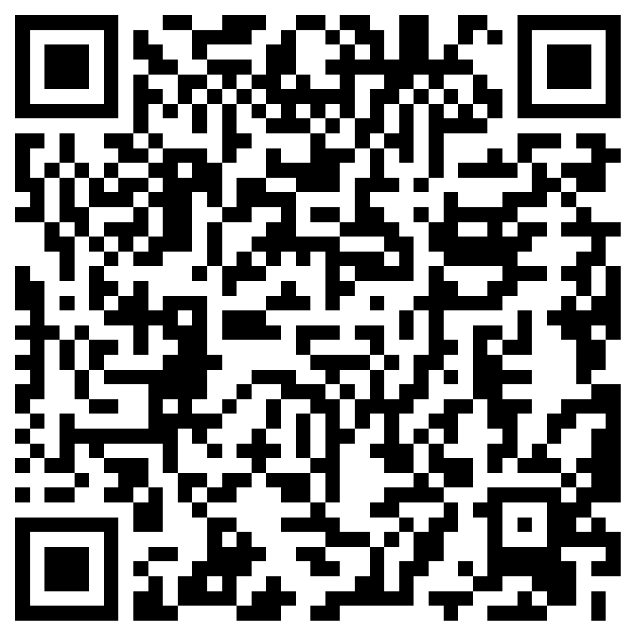
Meeting Dates
-9/20
-10/11 -10/25 – Report Cards due
-11/1 -11/15
-12/6 -12/16 – Celebration
-1/10 -1/24
-2/7 -2/8, 2/9, 2/10 – 8:15 AM – 9:15 AM – Tentative Valentine’s Fundraiser Volunteer Days -2/28
-3/14 -3/28
-4/11 -4/25 – Service Hours Due
-5/2 – Last Day to turn in Service Hours -5/9 – Induction Ceremony and End of Year Celebration
https://forms.office.com/r/6raTSXaFaf

Slide 10
QUESTIONS
Email – Marthe.jones@cobbk12.org
Email – Nina.copening@cobbk12.org
Email – Laura.demilio@cobbk12.org
Access Betaclub.org for more information about the club.

